Slide 1

SPOTIFY TREND ANALYSIS
Project Done by Ajith Kumar Ganesan

Slide 2
PROBLEM STATEMENT:
The objective of this project is to utilize Tableau's data visualization capabilities to analyze and present insights from Spotify data. This project seeks to leverage Tableau’s visualization capabilities to transform raw Spotify data into meaningful and interactive visualizations that enable users to gain insights, make data-driven decisions, and explore their music preferences in a visually engaging manner. As an analyst come up with the recommendation on suggesting advertisements to stay competitive in the music industry.
SUMMARY:
Designed an Interactive dashboard with given data using the TABLEAU visualisation tool and also used some Main Components of Country wise total Artist, Total Streaming, Year Wise Streaming, Monthly Streaming and Top 10 Popular tracks performed.
STEPS INVOLVED:
Data Collection
Data Preparation
Connect Tableau to Spotify Data
Explore and Visualize data
Create Dashboards
Interactivity and Filters
Publish and share

Slide 3
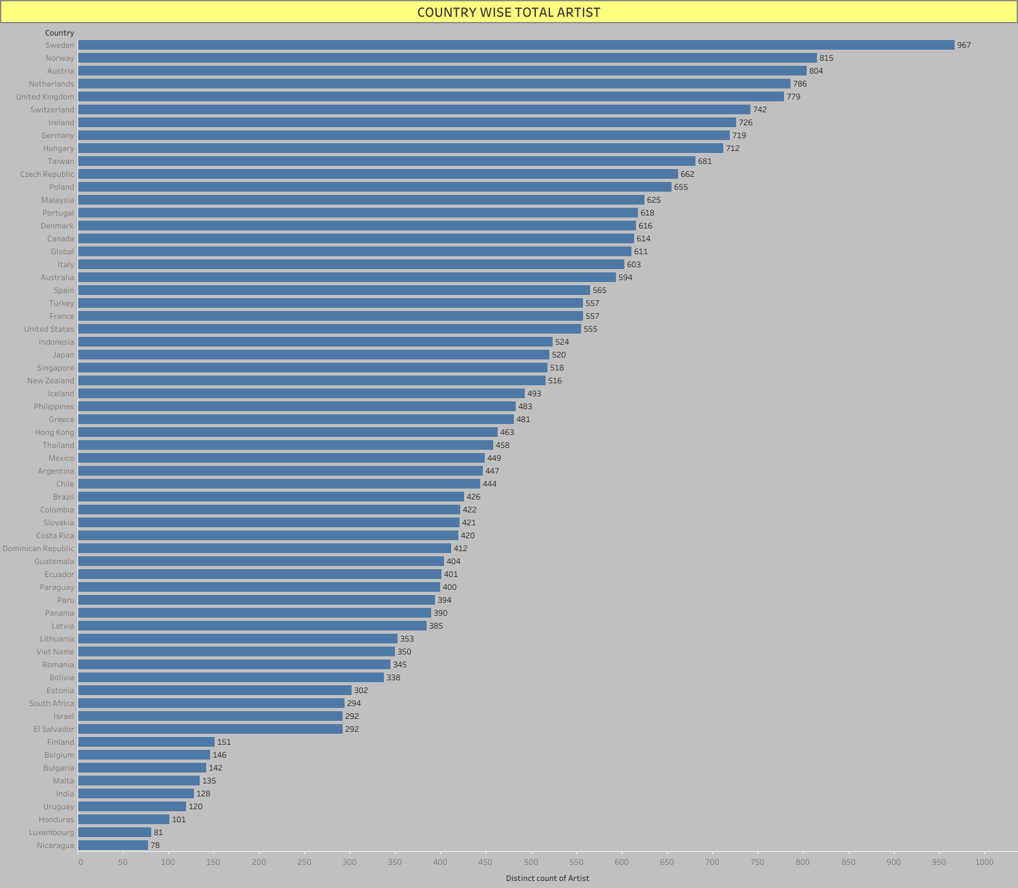

Slide 4
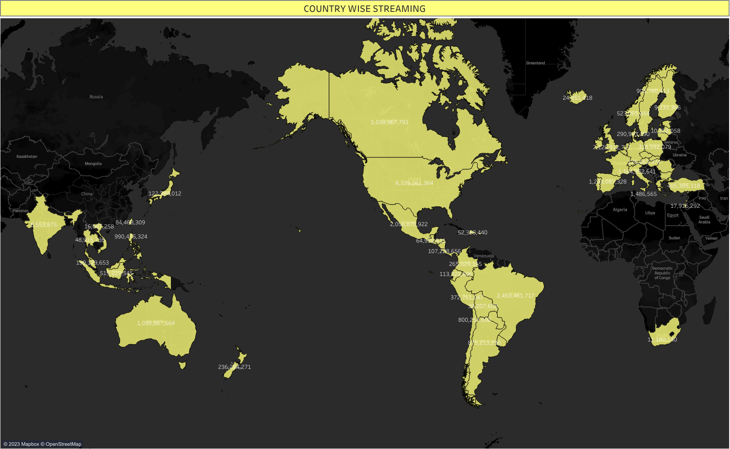

Slide 5
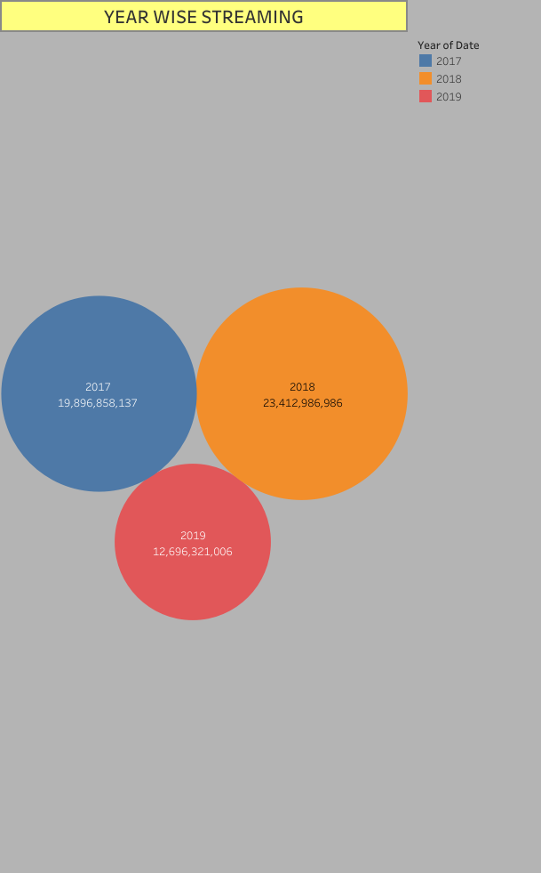

Slide 6
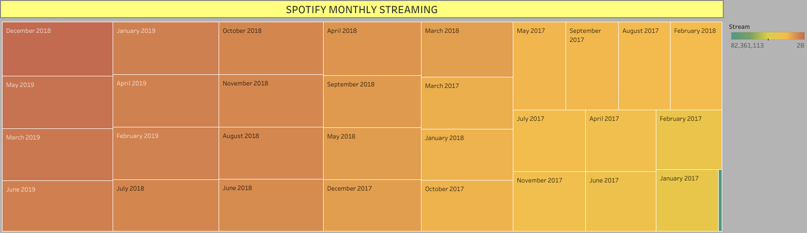

Slide 7
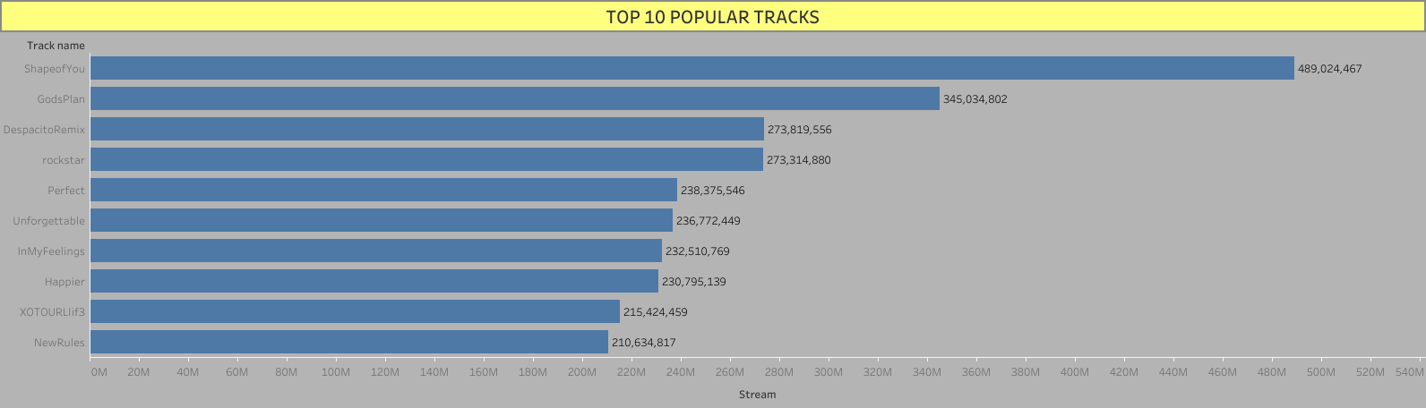

Slide 8
CONCLUSION:
INSIGHTS
Spotify's monthly streaming has increased by 20% year-over-year. This suggests that the platform is becoming increasingly popular and that there is a growing demand for music streaming services.
The top 10 popular tracks are dominated by English-language songs. This suggests that English-language music is still the most popular genre on Spotify, although there is some growth in the popularity of non-English-language songs.
The most popular artists in terms of total streams are global superstars like Drake, The Weeknd, and Taylor Swift. This suggests that these artists have a large and dedicated fan base that streams their music frequently.
Streaming habits vary by country. For example, the United States has the highest number of monthly streams, while India has the fastest-growing streaming market.
Spotify can use this data to make strategic decisions about its business. For example, the company could focus on promoting English-language songs in international markets, or it could sign more deals with local artists in emerging markets.

Slide 9
RECOMMENDATIONS
Spotify could create more personalized playlists for users based on their listening history.
Spotify could develop more features that allow users to interact with each other, such as social media integration or collaborative playlists.
Spotify could expand its offerings to include more live music, podcasts, and audiobooks.

